Slide 1
AGENTIQ-DATATHON:- TRACK3-AGRI-TECH
MANDI-TO-MARKET SUPPLY CHAIN OPTIMIZER
TEAM NAME:- ONLY ARSH
TEAM MEMBERS:- ARSHDEEP KAUR

Slide 2


MANDI-TO-MARKET SUPPLY CHAIN OPTIMIZER
AgentIQ leverages AI to enhance agricultural supply chain analytics, transforming fragmented data into actionable insights. By integrating diverse datasets, it empowers stakeholders—from farmers to market analysts—to make informed decisions. This innovative platform addresses critical challenges in data accessibility and usability, ultimately driving efficiency and profitability in the agricultural sector. Join us as we explore how AgentIQ revolutionizes supply chain intelligence.

Slide 3

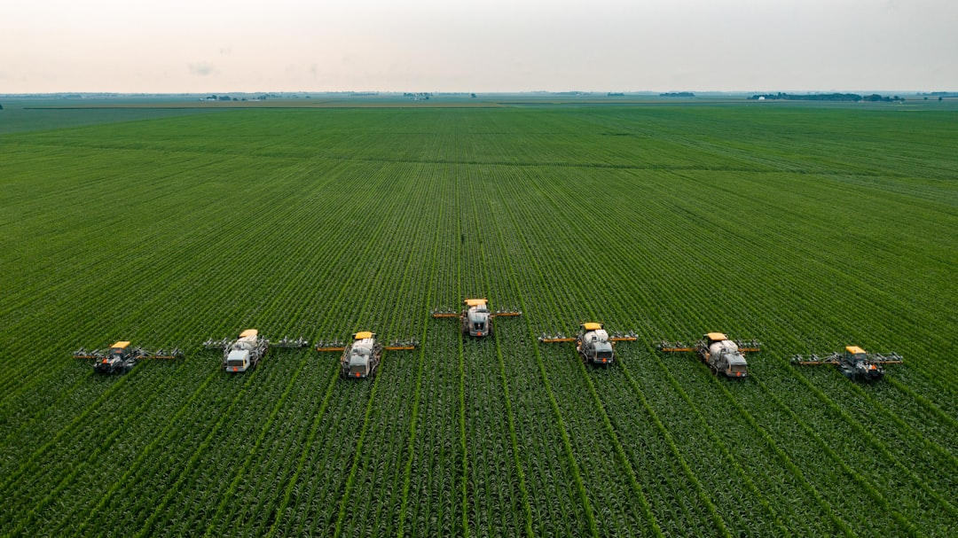


Understanding the Problem and Proposed Solution
Fragmented Data Sources
Unified Intelligence
Disparate datasets hinder effective decision-making in agricultural supply chains.
AgentIQ consolidates data for streamlined analysis and actionable insights.
Natural Language Queries
Data Analytics
Users can interact with data using intuitive, conversational AI queries.
Enhanced visibility into supply chain dynamics improves operational efficiency.
Photo by James Baltz

Slide 4

Problem Statement
Disparate Data Sources
Fragmented datasets lead to inefficiencies in agricultural supply chain management.
Inconsistent Data Formats
Diverse formats hinder reliable analysis and decision-making across platforms.
Manual Interpretation Errors
Relying on manual data interpretation increases the risk of critical signal oversight.
Photo by no one cares

Slide 5
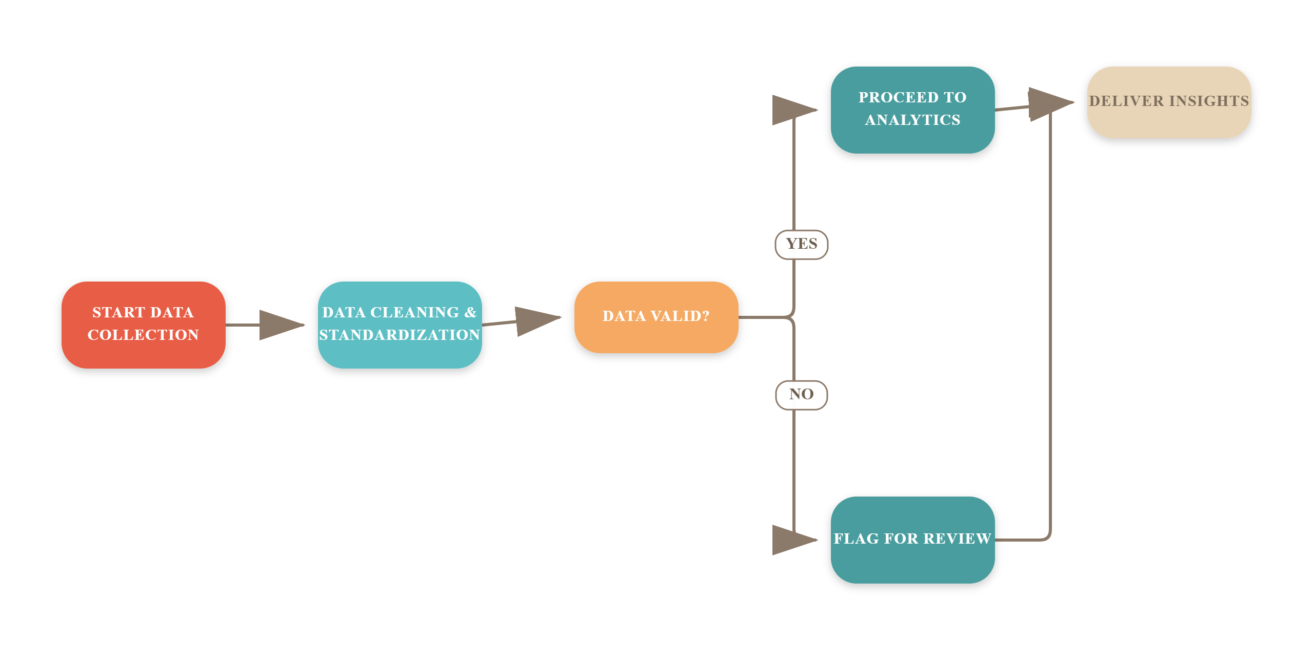
AgentIQ Solution Workflow

Slide 6

Technical Approach
Python for Data Cleaning
Utilizes Python for efficient data cleaning and analysis of agricultural datasets.
FastAPI Backend Framework
FastAPI serves as the backend, ensuring rapid API responses and scalability.
Responsive React Dashboard
The React dashboard provides a user-friendly interface for data visualization.
AI Agent Integration
Integrates an AI agent for natural language processing and user queries.
Secure Data Handling
Ensures secure handling of data through structured access and execution limits.
Photo by Chris Ensminger

Slide 7

Impact and Benefits
Farmers Gain Market Insights
Supply Chain Efficiency
Farmers can track market prices and MSP conditions effectively, enhancing profitability.
Operators can quickly identify transport delays, improving logistics management and response times.
Rapid Data-Driven Decisions
Analysts receive immediate, data-grounded answers, streamlining decision-making processes significantly.
Photo by Tim Mossholder

Slide 8


Transformative Impact of AgentIQ
30%
50%
100%
Reduction in Data Exploration Time
Increase in Decision-Making Speed
Integration of Disparate Datasets
Streamlining access to critical insights
Empowering faster, data-driven choices
Creating a unified view of agricultural data

Slide 9

Limitations
Synthetic Dataset Limitations
Weather Integration Gaps
Current dataset is synthetic and lacks real-time data integration.
Weather data is not yet linked to individual mandis for accurate forecasting.
Persistent Missing Values
AI Response Dependency
Despite cleaning efforts, some missing values still affect data reliability.
AI-generated answers rely heavily on the quality of available datasets.
No Live Price Feeds
Absence of live mandi-price feeds limits real-time market analysis capabilities.
Photo by Marios Gkortsilas

Slide 10

Future Scope
Integrate Live Data Feeds
Real-Time Transport Tracking
Incorporate real-time mandi and market-price feeds for enhanced decision-making.
Implement GPS tracking to monitor transport logistics and improve efficiency.
Expand Predictive Analytics
Wider Crop and Market Application
Broaden predictive capabilities for arrivals and pricing to optimize supply chain.
Extend AgentIQ's functionality to additional crops and agricultural markets.
Photo by Yulian Alexeyev

Slide 11
Frequently Asked Questions
?
What datasets are used in AgentIQ?
AgentIQ utilizes five key agricultural datasets, including mandi arrivals, market prices, transport logistics, weather data, and mandi information, all cleaned and standardized for analysis.
?
How does the AI agent improve usability?
The AI agent allows users to ask questions in natural language, making it easier to access insights without needing to navigate complex dashboards manually.
?
Can AgentIQ handle real-time updates?
Currently, AgentIQ does not support live updates; however, future enhancements aim to integrate real-time mandi and market-price feeds.
?
What technologies power AgentIQ?
AgentIQ is built using a robust technology stack, including Python, FastAPI, Pandas, NumPy, React, and MongoDB, ensuring efficient data processing and user interaction.

Slide 12
Key Takeaways
AgentIQ effectively unifies fragmented agricultural data, enhancing visibility and decision-making for farmers and supply-chain operators. By leveraging AI, users can query complex datasets naturally, leading to actionable insights. Future enhancements, such as real-time data integration and predictive analytics, will further optimize supply chain efficiency and resilience in agriculture.

